Slide 1
Topological Data Analysis
Discussion Session

Slide 2
QUESTIONS ANSWERED

Slide 3
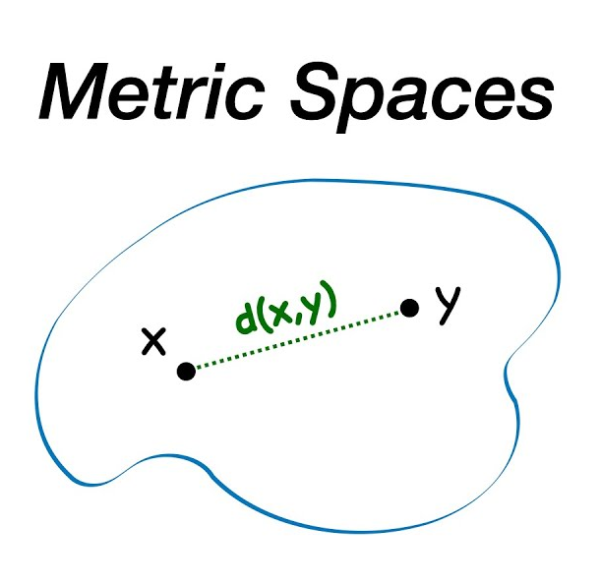
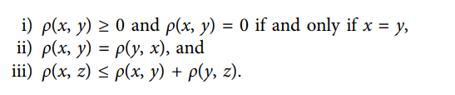
Metric Spaces
Definition:
A metric space is a set together with a notion of distance between its elements, usually called points. The distance is measured by a function called a metric or distance function
In simpler terms, a metric space provides a way of defining the distance between any two points in a set.

Slide 4

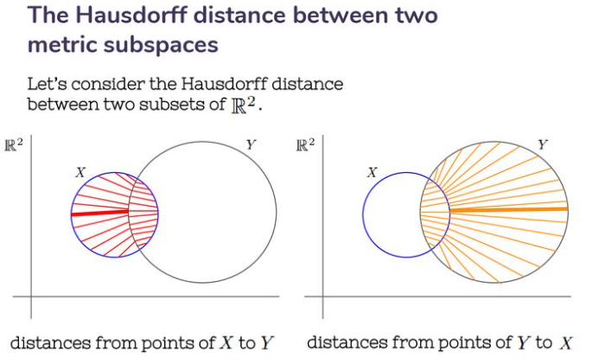
Hausdroff Distance
This distance measures how far two subsets of metric space are from each other.
It is the greatest distance of all the distance from a point in one set to the closest point in the other set.
Applied in Real Cases?
Matching Problem:
Determine how similar two shapes are.
Application: Measure the Hausdorff distance between the edge points of two shapes to quantify their similarity.
Object Recognition:
Problem: Identify objects in images.
Application: Compare the shape of detected objects with a template shape using the Hausdorff distance.
Change Detection Problem:
Detect changes in an object or area over time.
Application: Calculate the Hausdorff distance between images taken at different times to identify significant changes.
Definition:
Given two non-empty subsets X and Y of a metric space (𝑋,𝑑), the Hausdorff distance d H​ (X,Y) is defined as:

Slide 5
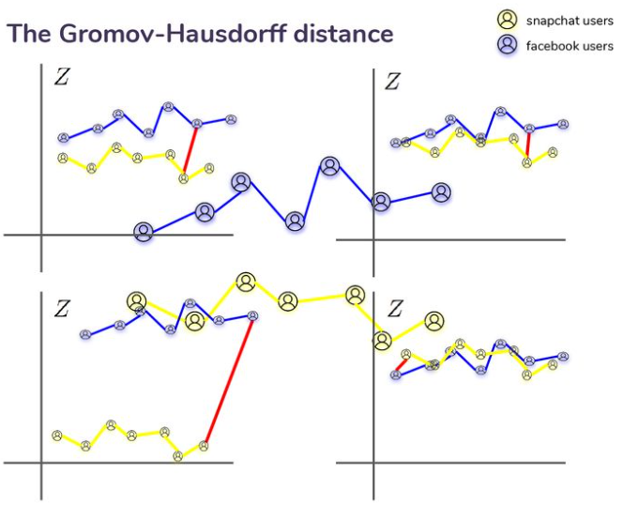

Gromov Hausdroff Distance
This distance measures how far two compact metric spaces are from being isometric.
Definition
If X and Y are two compact metric spaces, then dGH (X, Y) is defined to be the infimum of all numbers dH(f(X), g(Y)) for all (compact) metric spaces M and all isometric embeddings f : X → M and g : Y → M. Here dH denotes Hausdorff distance between subsets in M.
where 𝜑𝑋:𝑋→𝑍φ X​ :X→Z and 𝜑𝑌:𝑌→𝑍φ Y​ :Y→Z are isometric embeddings of 𝑋X and 𝑌Y into a common metric space 𝑍Z, and 𝑑𝐻d H​ denotes the Hausdorff distance in 𝑍Z.

Slide 6
Gromov Hausdroff Distance- continued
Applied in Real Cases?
Shape Comparison:
Problem: Compare the overall structure of two 3D shapes.
Application: Use the Gromov-Hausdorff distance to measure how similar the shapes are, independent of their specific embedding in space.
Clustering in Machine Learning:
Problem: Cluster data sets based on their intrinsic geometric properties.
Application: Use the Gromov-Hausdorff distance to compare data sets and cluster them based on their metric properties.
Comparing Biological Structures:
Problem: Compare the shapes of biological structures (e.g., proteins) that may not be easily aligned.
Application: Use the Gromov-Hausdorff distance to quantify the similarity between structures, accounting for variations in shape and size.

Slide 7
Difference Between Hausdorff and Gromov-Hausdorff Distances
Hausdorff Distance:
Applies to subsets within a common metric space.
Measures the maximum distance between the closest points of two sets.
Gromov-Hausdorff Distance:
Applies to entire metric spaces.
Measures the minimum distance when embedding the spaces into a common metric space.
More general and complex, considering the overall shape and structure of the spaces.

Slide 8
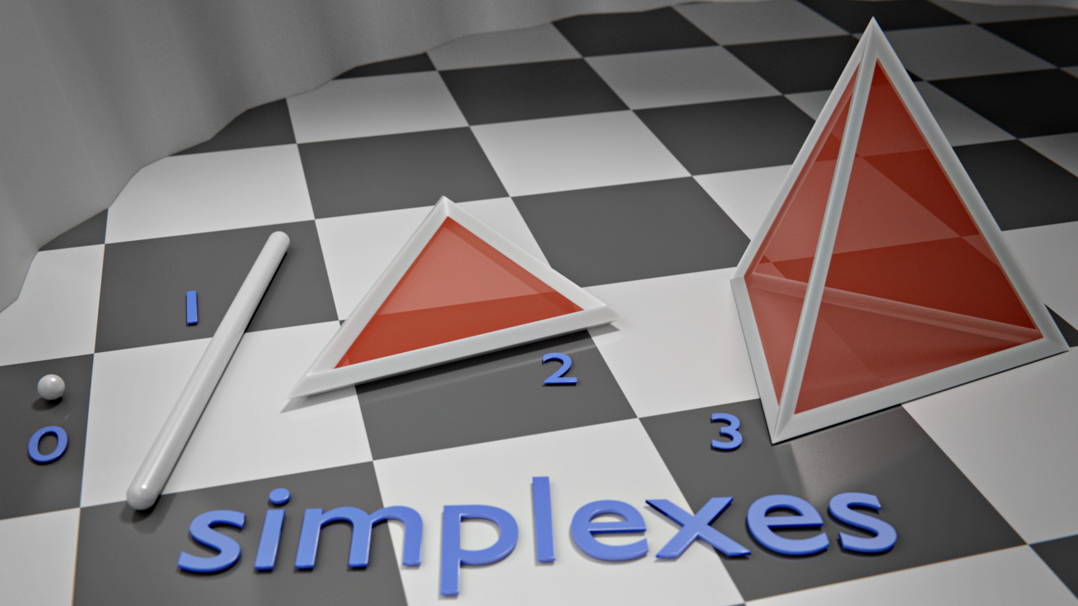
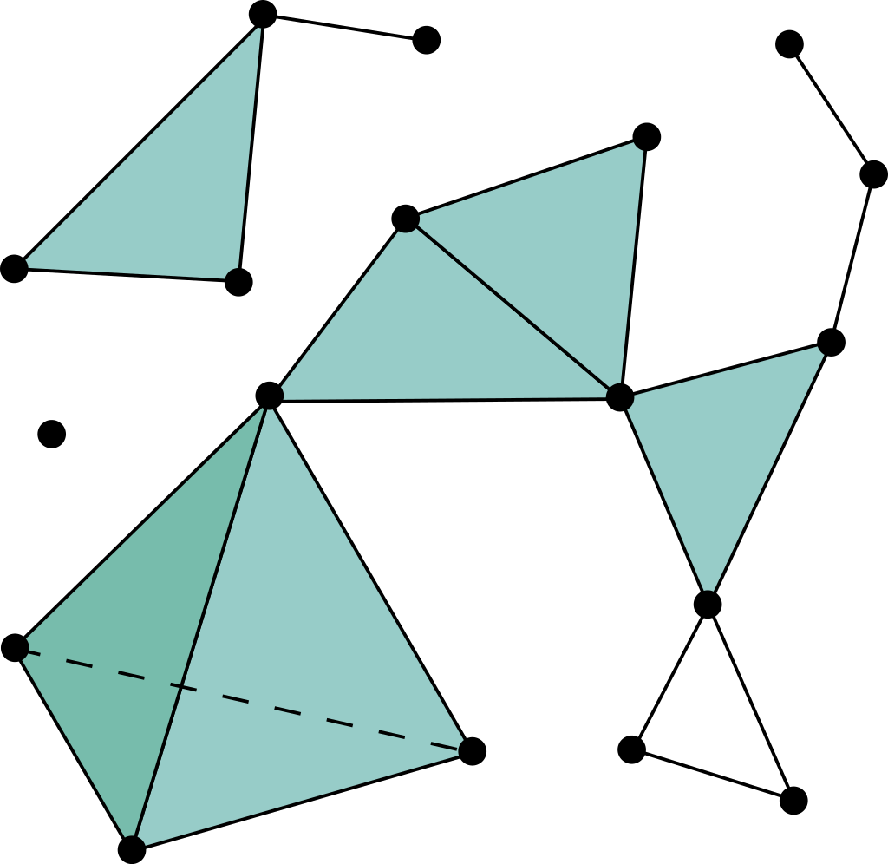
Simplicial Complex
What is simplex?
A simplex (plural: simplexes or simplices) is a generalization of the notion of a triangle or tetrahedron to arbitrary dimensions. The simplex is so named because it represents the simplest possible polytope in any given dimension. For example,
0-dimensional simplex is a point,
1-dimensional simplex is a line segment,
2-dimensional simplex is a triangle,
3-dimensional simplex is a tetrahedron, and
4-dimensional simplex is a 5-cell.
Specifically, a k-simplex is a k-dimensional polytope that is the convex hull of its k + 1 vertices.
Definition
A simplicial complex 𝐾 is a set of simplices that satisfies the following conditions:
Every face of a simplex from 𝐾 is also in 𝐾.
The non-empty intersection of any two simplices 𝜎 1 , 𝜎 2 ∈ 𝐾 is a face of both 𝜎 1 and 𝜎 2.

Slide 9
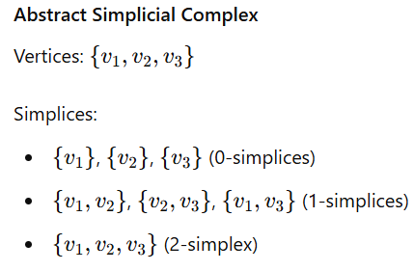
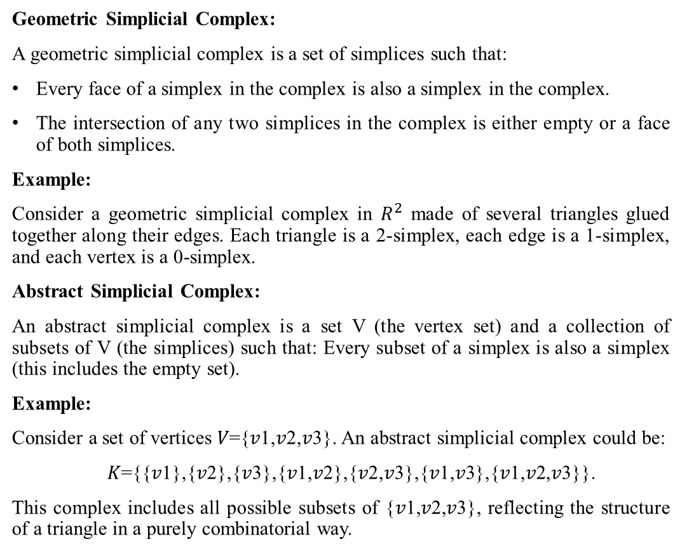
Geometric and Abstract Simplicial complex
Geometric Simplicial Complex:
A geometric simplicial complex is a set of simplices such that:
Every face of a simplex in the complex is also a simplex in the complex.
The intersection of any two simplices in the complex is either empty or a face of both simplices.
Example:
Consider a geometric simplicial complex in $R^{2}$ made of several triangles glued together along their edges. Each triangle is a 2-simplex, each edge is a 1-simplex, and each vertex is a 0-simplex.
Abstract Simplicial Complex:
An abstract simplicial complex is a set V (the vertex set) and a collection of subsets of V (the simplices) such that: Every subset of a simplex is also a simplex (this includes the empty set).
Example:
Consider a set of vertices 𝑉={𝑣1,𝑣2,𝑣3}. An abstract simplicial complex could be:
𝐾={{𝑣1},{𝑣2},{𝑣3},{𝑣1,𝑣2},{𝑣2,𝑣3},{𝑣1,𝑣3},{𝑣1,𝑣2,𝑣3}}.
This complex includes all possible subsets of {𝑣1,𝑣2,𝑣3}, reflecting the structure of a triangle in a purely combinatorial way.

Slide 10
Difference between Geometric and Abstract Simplicial complex
Geometric Simplicial Complex:
Represents shapes and spaces in a geometric manner.
Simplices are actual geometric objects in some Euclidean space.
Abstract Simplicial Complex:
Represents the combinatorial structure of how simplices are connected.
Simplices are sets of vertices without an intrinsic geometric realization.

Slide 11
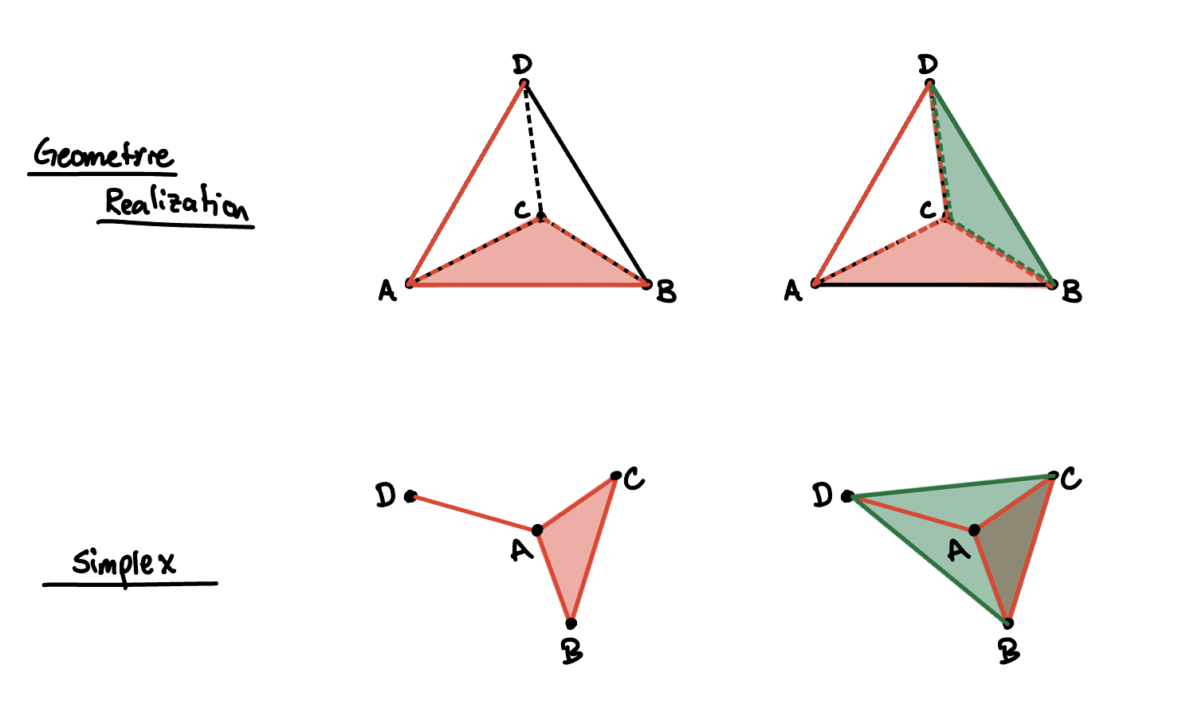
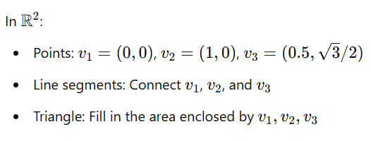
Term: Geometric Realization
What is Geometric Realization?
Geometric realization refers to the process of representing an abstract simplicial complex as a geometric simplicial complex in an Euclidean space. Essentially, it involves assigning actual geometric shapes (points, line segments, triangles, etc.) to abstract simplices in a way that preserves their combinatorial structure.
Example:

Slide 12
WAYS OF BUILDING SIMPLICIAL COMPLEXES

Slide 13
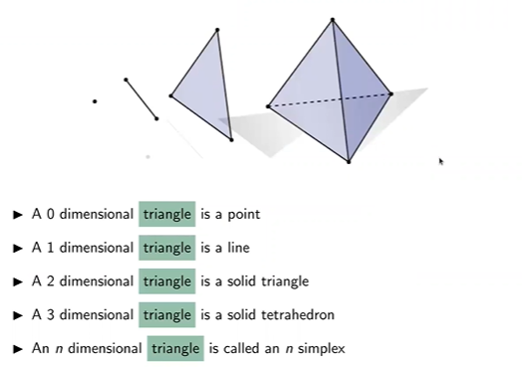
Simplicial Complexes can simply be defined as TRIANGLES EVERYWHERE. A good diagram illustrating the creation of simplicial complexes using triangles can be seen below:

Slide 14
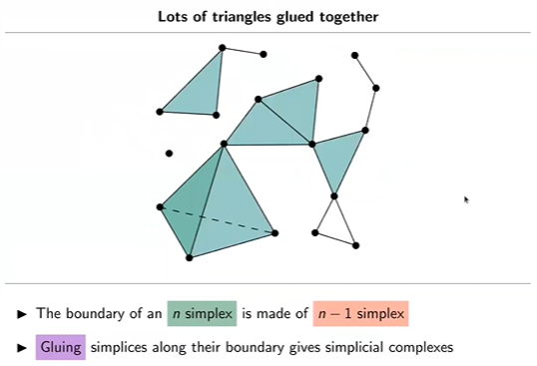
An illustration of a combination of these triangles at various dimensions to create a simplicial complex:

Slide 15
There are various ways to building a simplicial complexes. This includes:
Vietoris-Rips Complex (MATERIAL)
Cech Complex (MATERIAL)
Delaunay Triangulation
Alpha Complex

Slide 16
DIFFERENTIATING VIETORIS-RIPS COMPLEX AND THE CECH COMPLEX
The Vietoris-Rips complex uses a distance function to form simplicial complexes. A k-simplex is included if every pair of its vertices is within a specified distance threshold “ϵ” of each other. In simpler terms, it uses a pairwise distance function to create the simplicial complexes.
The Čech complex utilizes a radius, a distance function, and spheres (or circles in 2D). A k-simplex is included if the (k+1) spheres centered at its vertices have a common intersection.

Slide 17
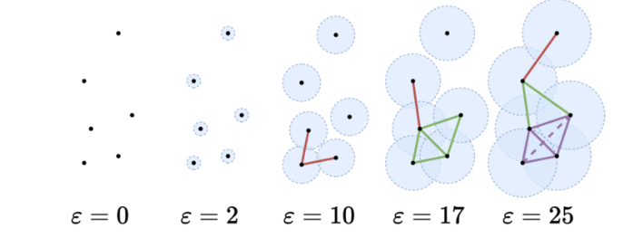
CECH COMPLEX:
PICTORIAL ILLUSTRATION

Slide 18
CECH COMPLEX:
GIF ILLUSTRATION

Slide 19
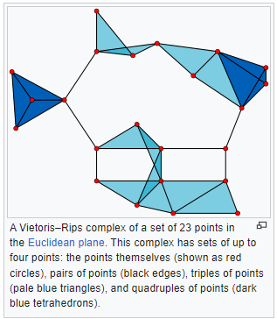
VIETORIS-RIPS COMPLEX:
PICTORIAL ILLUSTRATION
PRACTICAL ILLUSTRATION
A practical illustration of the Vietoris-Rips Complex is visualised in this link - https://www.geogebra.org/m/ye79r6ws

